Slide 1
IT4 CALCULUS 1 LESSON 4

Slide 2




CALCULUS DEFINITION OF DERIVATIVE

Slide 3


CALCULUS DEFINITION OF DERIVATIVE

Slide 4





CALCULUS EXAMPLE

Slide 5







CALCULUS EXAMPLE

Slide 6

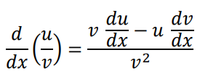
CALCULUS – DIFFERENTATION RULES

Slide 7




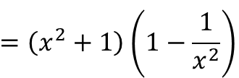




CALCULUS – DIFFERENTATION RULES EXAMPLE

Slide 8




CALCULUS – DIFFERENTATION RULES EXAMPLE

Slide 9



CALCULUS – DIFFERENTATION RULES EXAMPLE - EXERCISE

Slide 10


CALCULUS CHAIN RULE

Slide 11
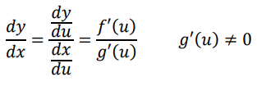
CALCULUS CHAIN RULE

Slide 12







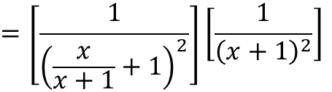



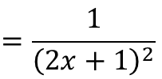
CALCULUS - CHAIN RULE EXAMPLE

Slide 13

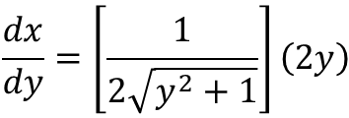
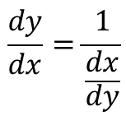
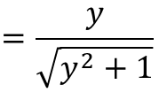
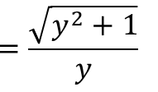
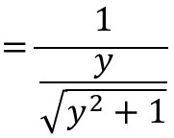
CALCULUS - CHAIN RULE EXAMPLE

Slide 14
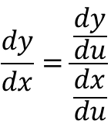
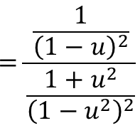



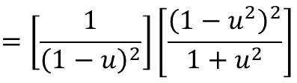


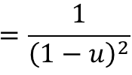
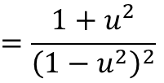
CALCULUS - CHAIN RULE EXAMPLE

